Slide 1

Public Health Brigades Information Session
May 17-29, 2022
Notes:
[ Throughout the notes section of this presentation is additional information pertaining to each slide. Each slide will only have brief bullet points (to prevent the viewer from being distracted by long paragraphs; the presenter should supplement each bullet point with the additional information provided here ]

Slide 2
About
Global Brigades
OUR MISSION
To empower volunteers and under-resourced communities to resolve global health and economic disparities and inspire all involved to collaboratively work towards an equal world.
GLOBAL BRIGADES IS AN INTERNATIONAL NON-PROFIT that empowers communities to meet their health and economic goals through university volunteers and local teams.
OUR VISION
To improve equality of life, by igniting the largest student-led social responsibility movement on the planet.
Notes:
Global Brigades is the world’s largest student-led global health and sustainable development organization. As a secular, international nonprofit organization, we mobilize student volunteers and professionals to empower communities in developing countries with programs that improve quality of life and environment, while respecting local culture. Students and professionals empower communities in Honduras, Panama, and Nicaragua.

Slide 3

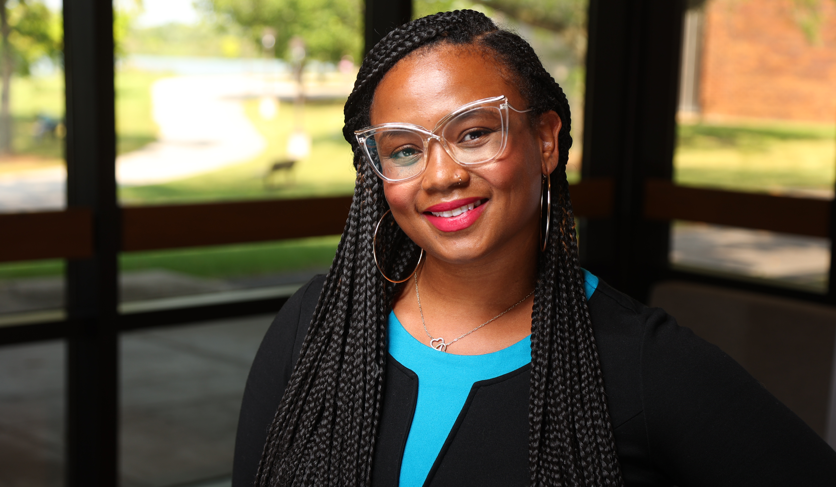
GSU Faculty Leaders
Dr. Nicole Koonce, Ph.D., CHHS
Department of Communication Disorders
Mission Trips to Haiti
Led 4 GSU Brigades to Nicaragua, Panama, and Ghana
Dr. Roseina Britton, Ph.D., COE
Division of Psychology and Counseling
Local service
Study abroad in Greece
First GSU Brigade

Slide 4
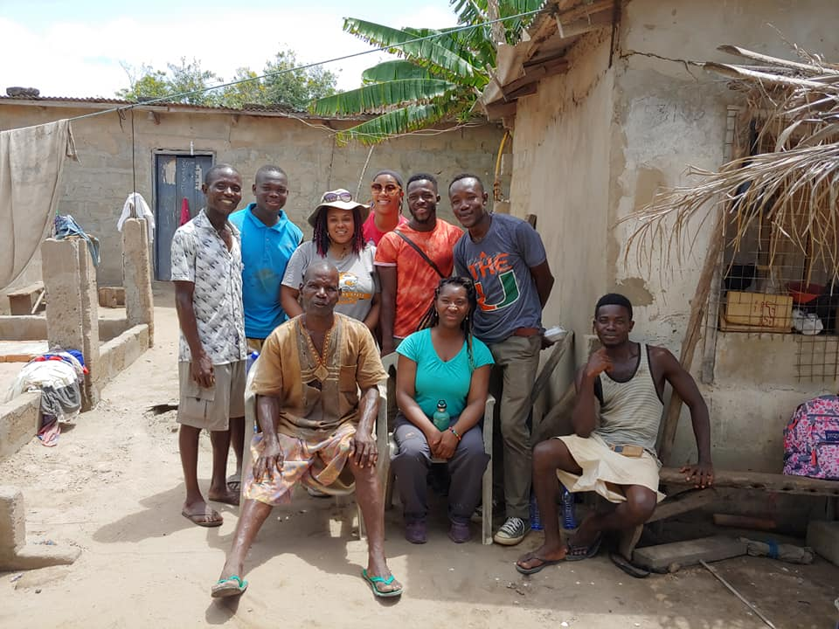
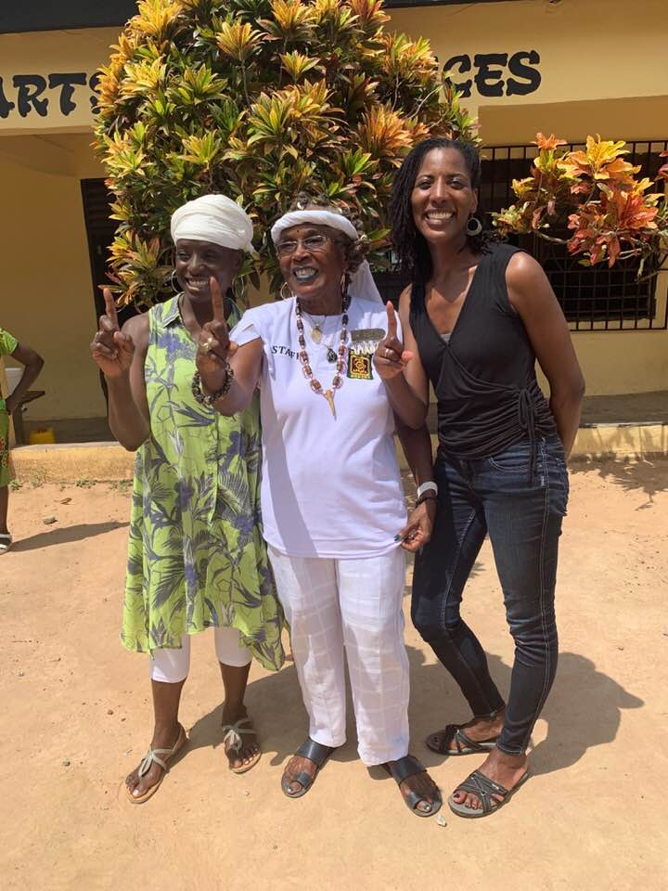
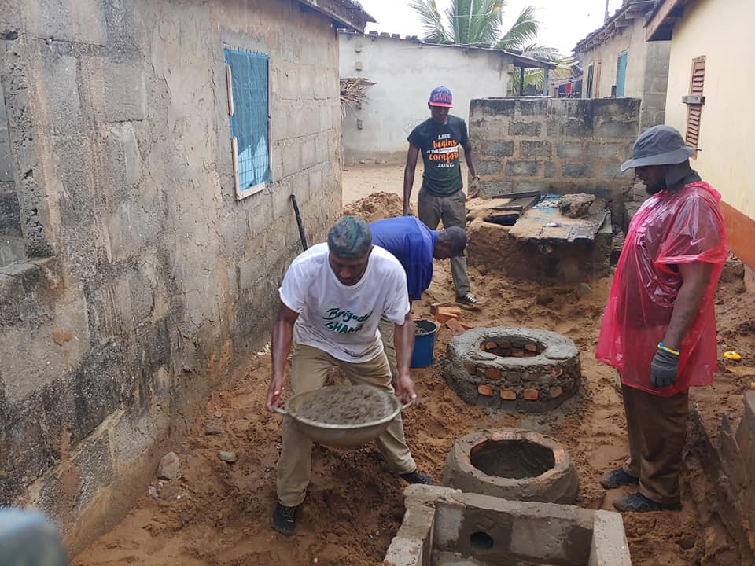
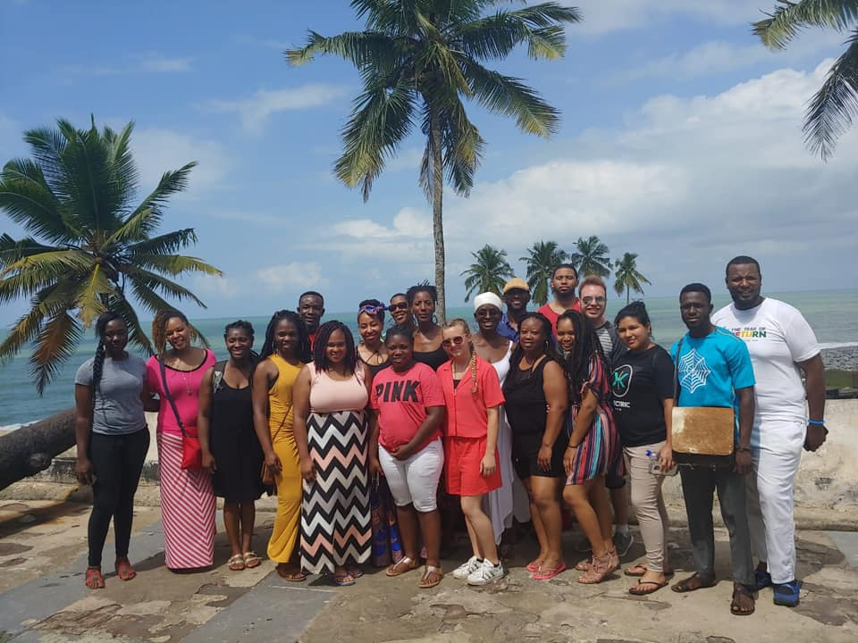
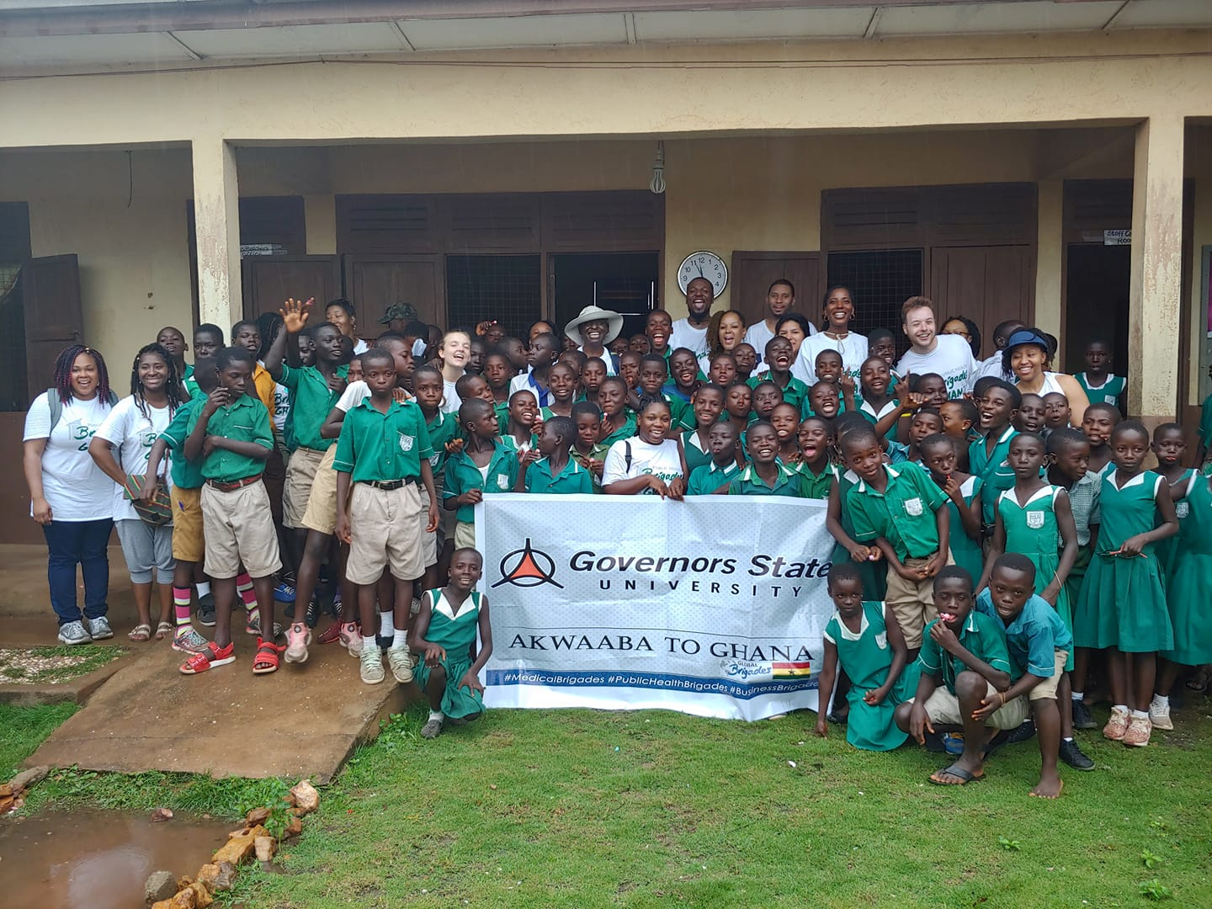
Ghana Photos 2019

Slide 5
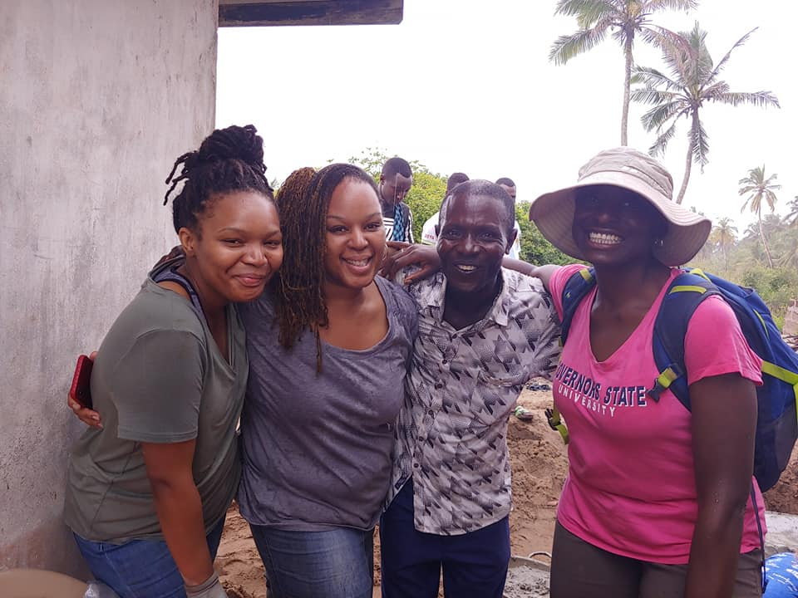
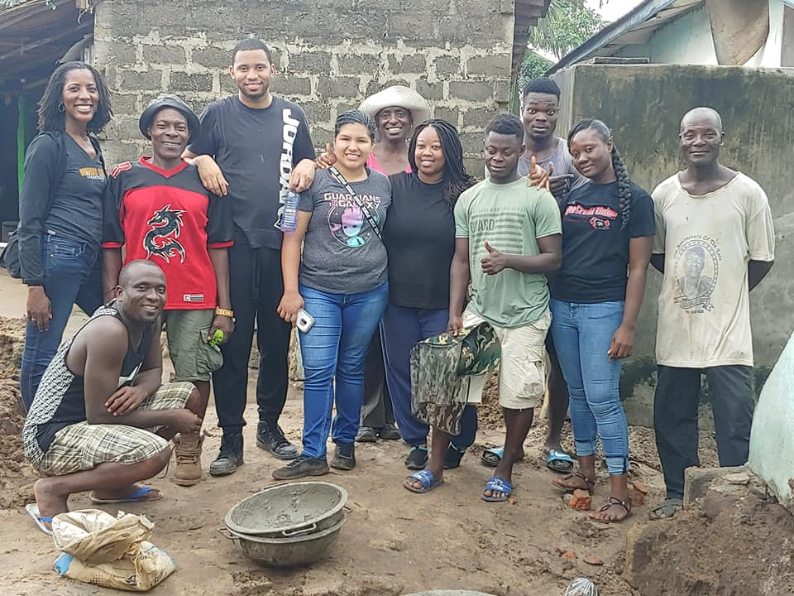
Public Health Brigade to Ghana
Click on the link above to view the video testimonials from 2019 participants!

Slide 6




About Global Brigades
7 SKILL BASED PROGRAMS OPERATING ACROSS 3 COUNTRIES
HONDURAS
Medical
Dental
Engineering
Water
Public Health
Business
Legal Empowerment
PANAMA
Medical
Dental
Public Health
Business
Legal Empowerment
GHANA
Medical
Water
Public Health
Business
NICARAGUA
Volunteer Brigades
in Nicaragua are currently unavailable, although our local team is still actively implementing the Holistic Model

Slide 7
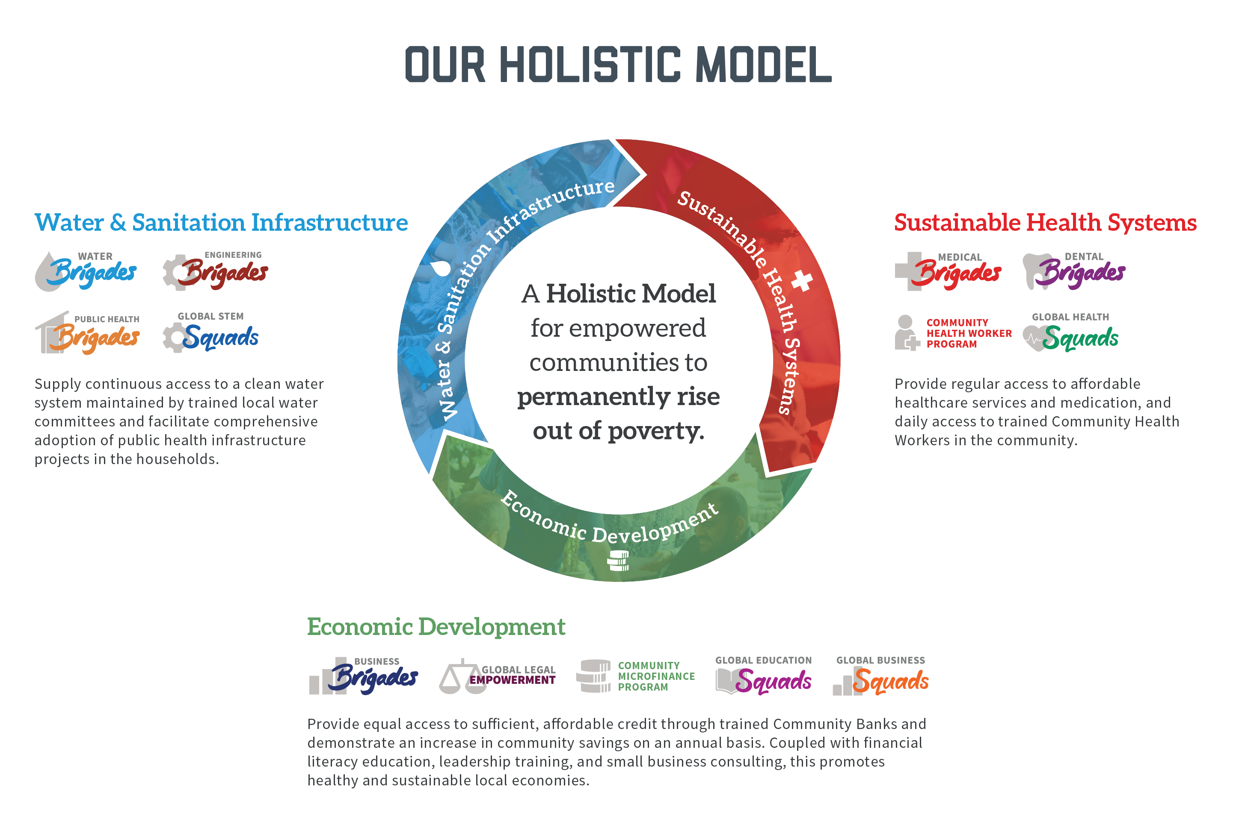
Global Brigades delivers integrated health and economic programs to meet a community’s development goals.

Slide 8
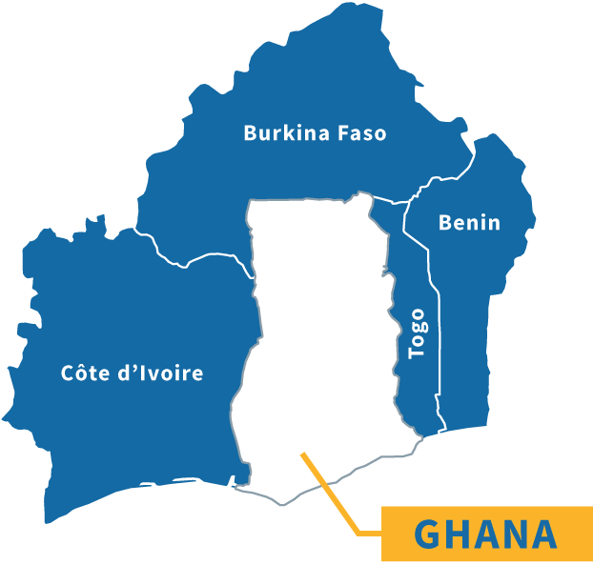
Ghana
RURAL GHANA
12.9 million people⁺
^{Total Population: 28.8 million}
Over 4.3 million people lack access to clean water⁺
Over 11.7 million people lack access to improved sanitation infrastructure
37.9% of rural population lives below the poverty line⁺
1,641.49 USD GDP per capita⁺
Over 43% of children ages 12-17 are not enrolled in school
Notes:
⁺information from World Data Bank 2015

Slide 9
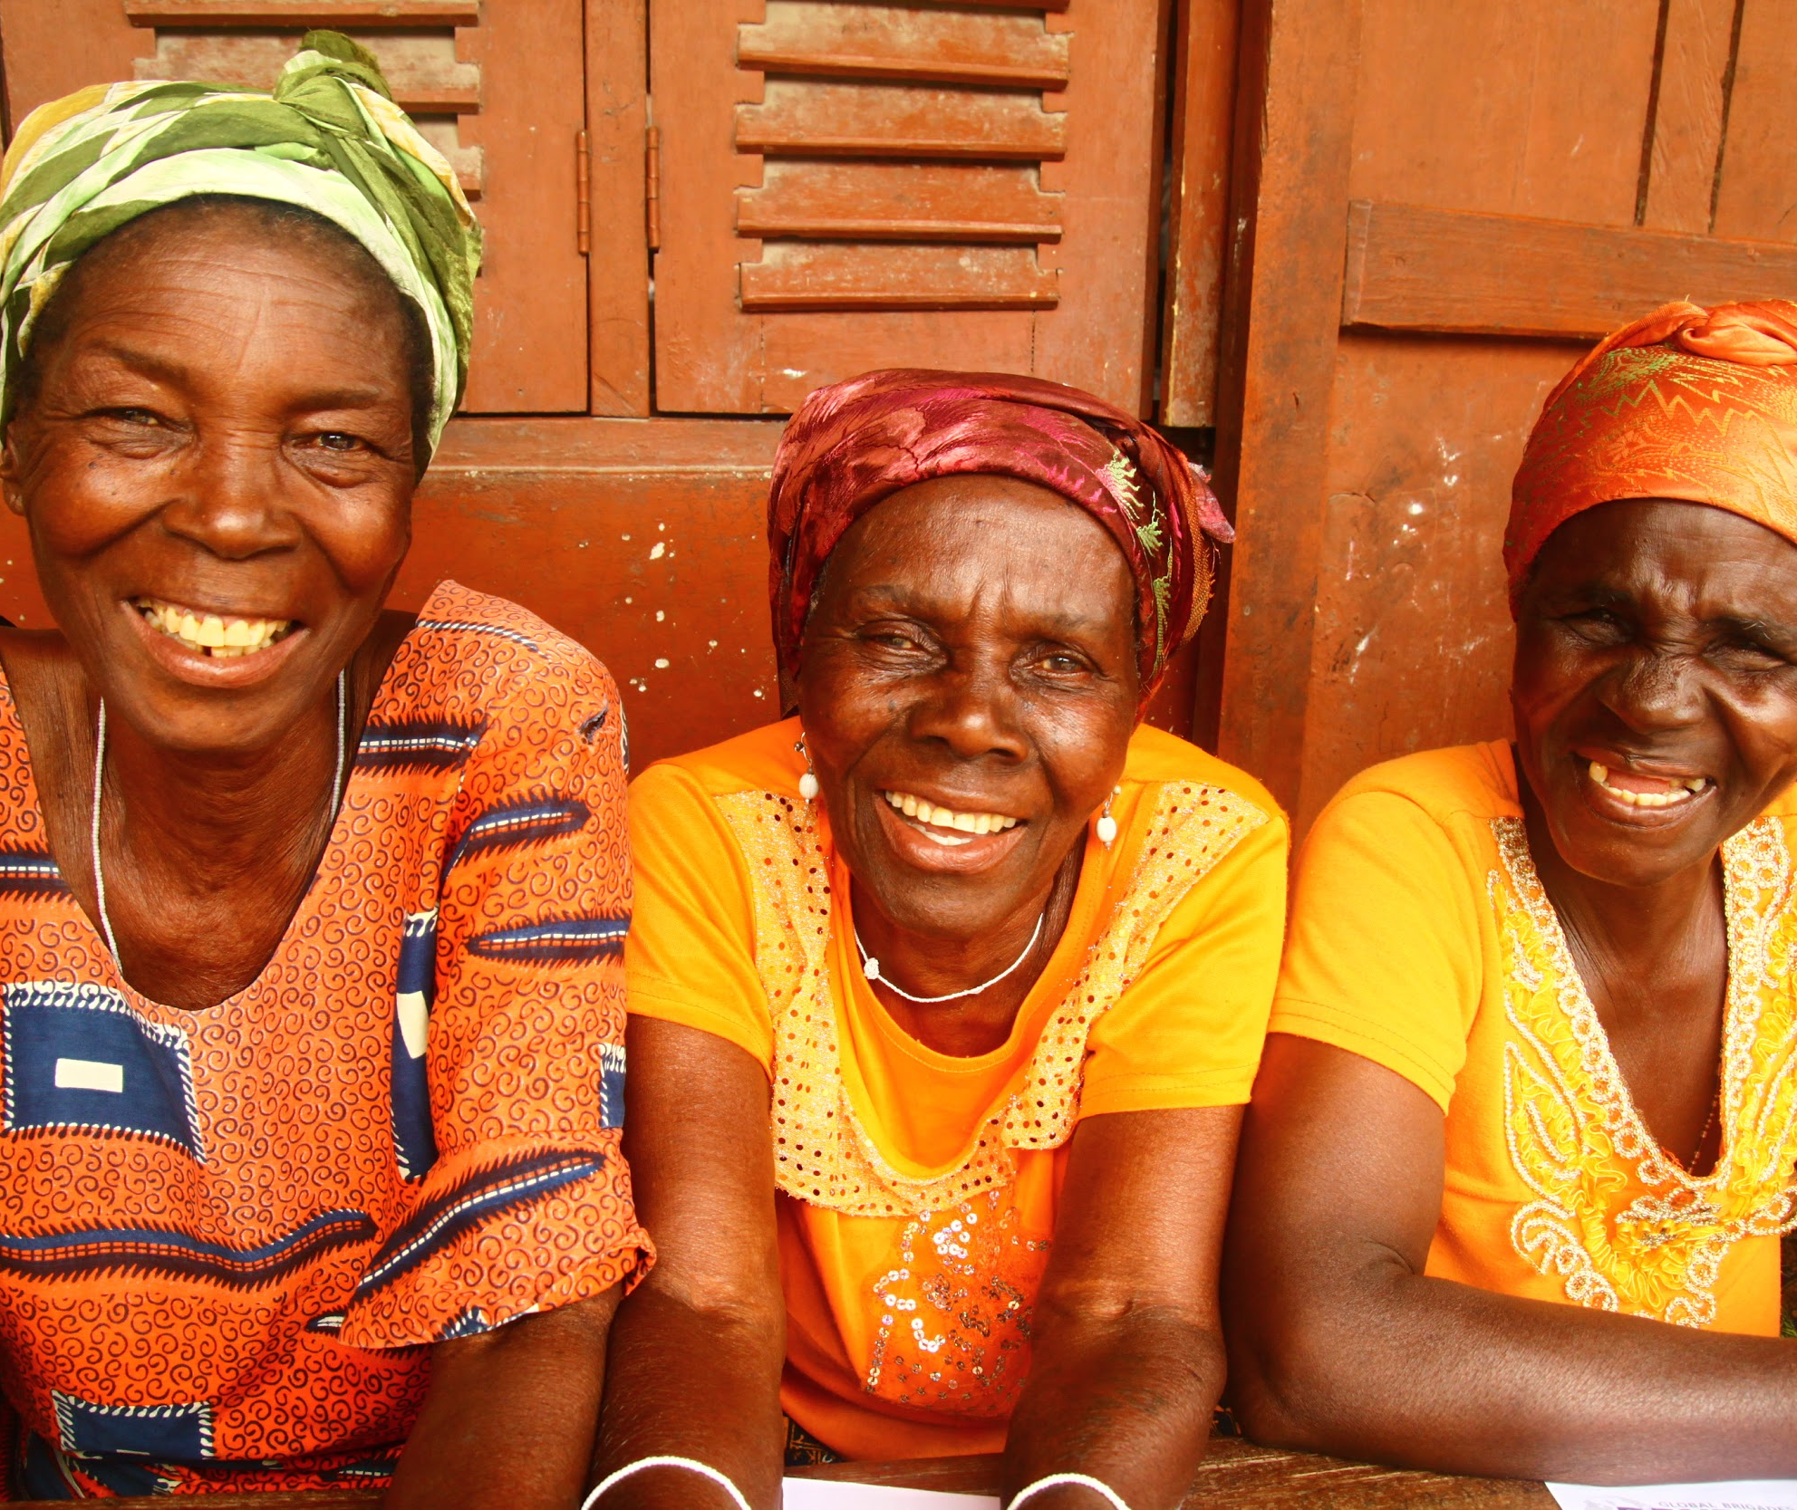
Why Public Health?

Slide 10



Why Public Health? The Challenges
91%
of people in rural Ghana lack access
to basic or safely managed sanitation facilities.
Notes:
Source: Health Indicator database. Regional Initiative of Health Indicator, Pan American Health Organization (PAHO), 2009. http://ais.paho.org/phip/viz/cip_coverageandsanitation.asp
“Improved” sanitation infrastructure considered connection to a public sewer, connection to a septic system, pour-flush latrine, access to a pit latrine, or access to a ventilated improved pit latrine

Slide 11
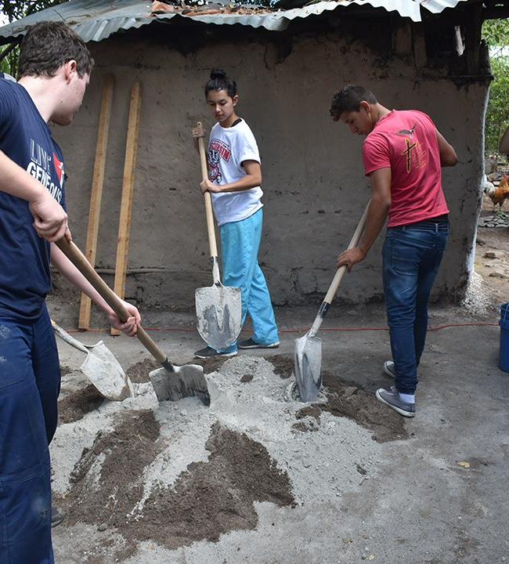
Why Public Health? The Challenges
HEALTH
Open defecation is an issue that must be addressed in rural Ghana
Inability to store clean water reduces overall water use for personal consumption
SANITATION AND HYGIENE
Lack of proper latrines expose families to risks of contamination
TIME AND QUALITY OF LIFE
Walking to water sources can be time consuming and heavy on the body
Improved sanitation and hygiene practices decrease frequency of commonly occurring diseases
Notes:
"The World Health Organization (WHO) estimates that exposure to smoke from the simple act of cooking constitutes the fourth leading risk factor for disease in developing countries, and causes 4.3 million premature deaths per year – exceeding deaths attributable to malaria or tuberculosis. In addition, tens of millions more fall sick with illnesses that could readily be prevented with improved adoption of clean and efficient cookstoves and fuels.' - Global Alliance for Clean Cookstoves
"Typical wood-fired cookstoves and open fires emit small particles, carbon monoxide, and other noxious fumes that are up to 100 times higher than the recommended limits set by WHO, and in some settings, considerably higher."- Global Alliance for Clean Cookstoves
"Around 3 billion people cook and heat their homes using open fires and simple stoves burning biomass (wood, animal dung and crop waste) and coal.
Over 4 million people die prematurely from illness attributable to the household air pollution from cooking with solid fuels.
More than 50% of premature deaths due to pneumonia among children under 5 are caused by the particulate matter (soot) inhaled from household air pollution.
3.8 million premature deaths annually from noncommunicable diseases including stroke, ischaemic heart disease, chronic obstructive pulmonary disease (COPD) and lung cancer are attributed to exposure to household air pollution."- WHO

Slide 12
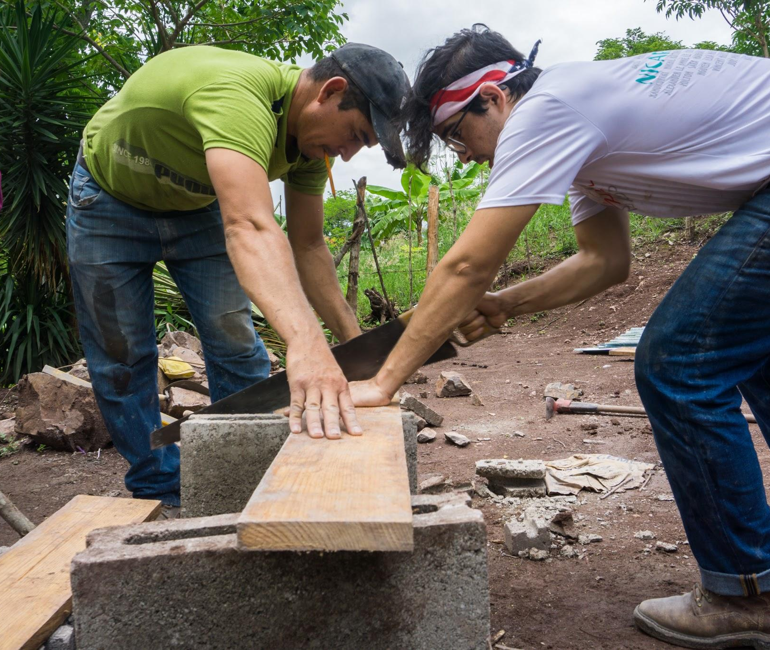
Public Health
Program
Public Health's mission is to empower rural Ghanaian communities to prevent common illnesses through in-home infrastructural development, community leader training, and health education.

Slide 13
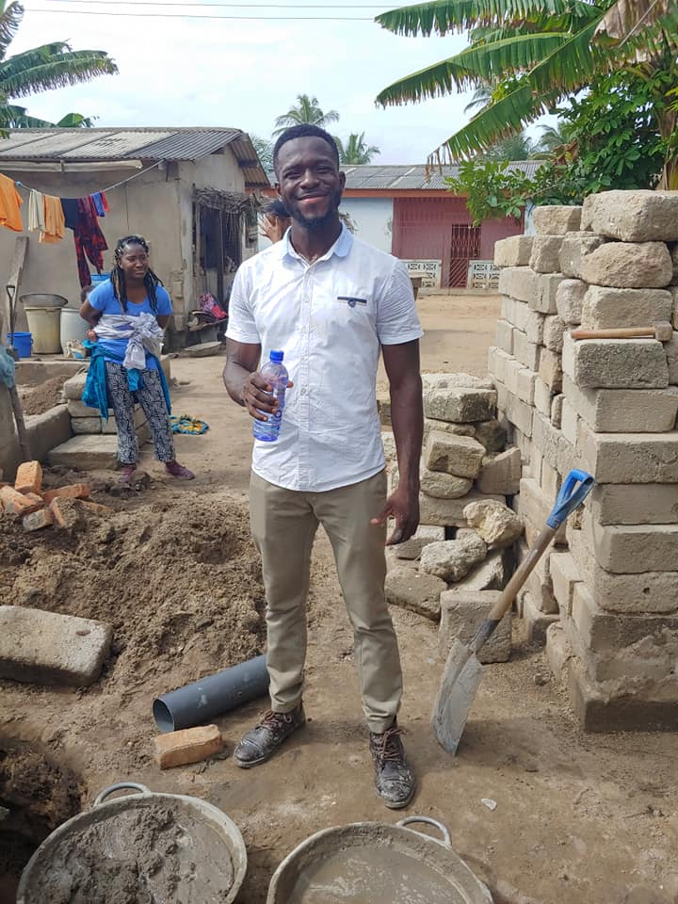
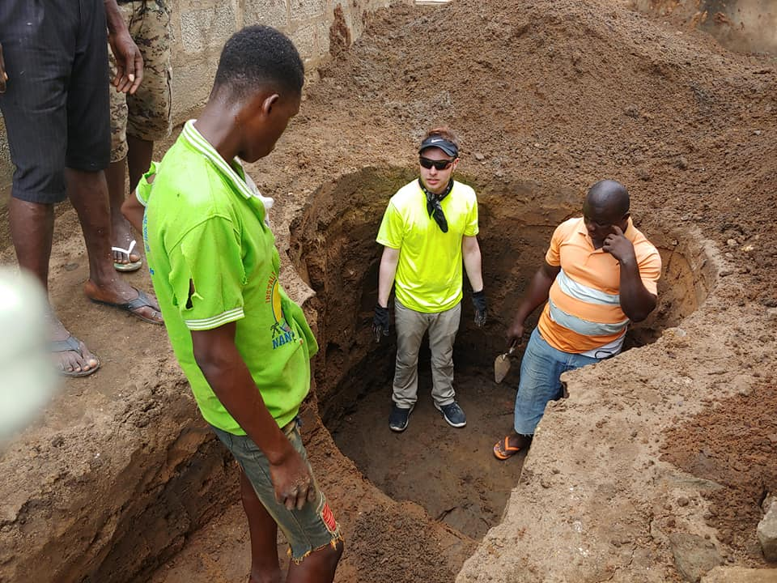
Meet the Team
PUBLIC HEALTH PROGRAM TEAM
Builds community relations
  Works with communities in preparation for brigade arrival
Capacity-building and education
Performs community follow-up and evaluations
Leads your brigade

Slide 14
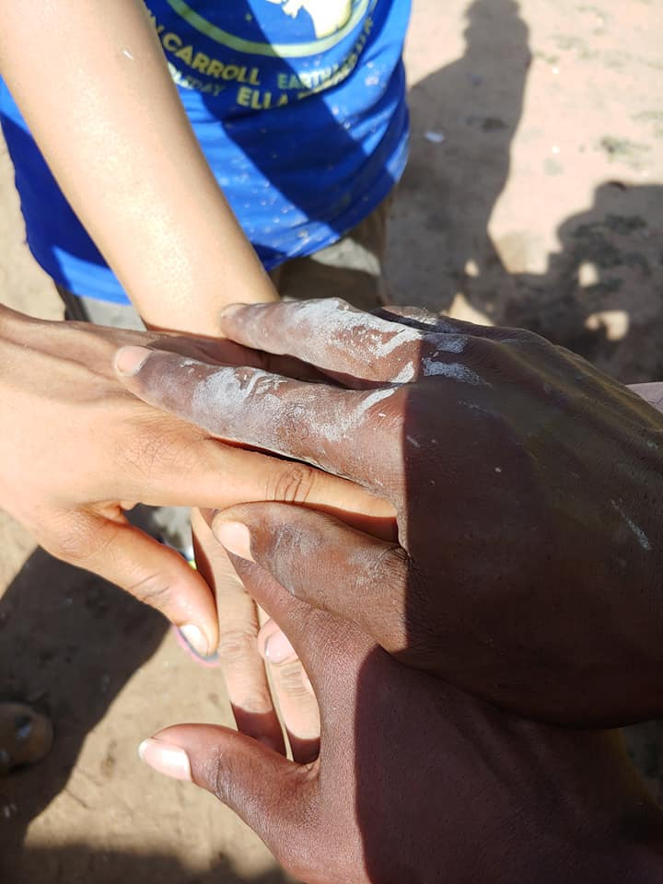
The Public Health Program
THE PUBLIC HEALTH PROGRAM IN GHANA CONSISTS OF:
Infrastructure Development
  Advocate for Public Health projects and help instruct proper usage and maintenance of infrastructure
Healthy Households Initiative
  Monitor and evaluate household health environments
Community Health Workers (CHWs)
  Community volunteers who provide patient care in order to promote preventative health care and overall community health
Maintenance and Follow-Up
  Full time staff working year-round as resources and mentors in communities
Public Health Brigades
  Volunteers construct household health infrastructure projects and collaborate with the and CHWs on project follow-up and community education, securing access to resources and information necessary to promote good sanitation and hygiene practices

Slide 15
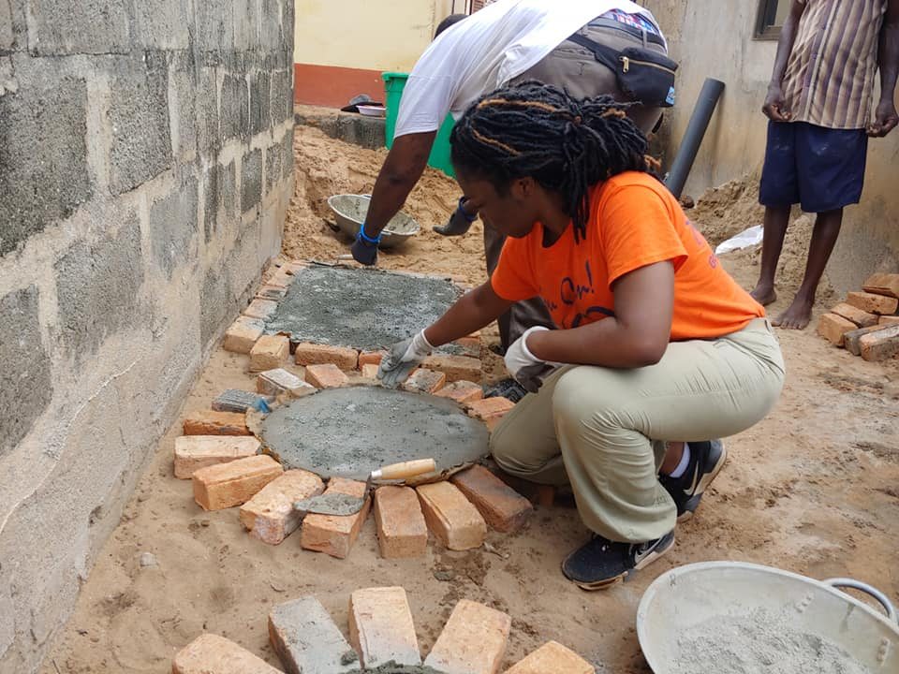
Public Health Projects
LATRINES
Build latrines for sanitary and proper waste disposal
A convenient and inexpensive solution near the home
Biodigester septic tank included in design

Slide 16
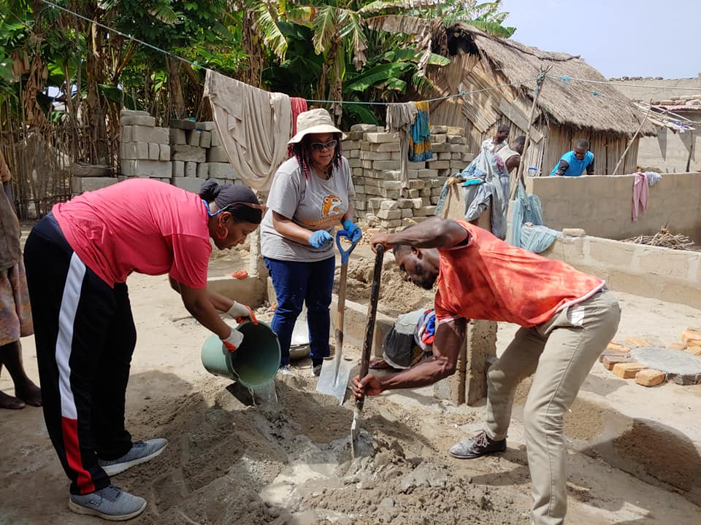
Public Health
Brigades
Notes:
The community benefits greatly from direct volunteer involvement. It is a huge motivational factor to see volunteers committed to a community’s access to needed public health infrastructure. In addition they benefit from the education workshops given by student volunteers. Each volunteer also indirectly supports, through their program contributions, sustainability aspects like training a water council, and allowing staff to check up with communities and confirm that the systems are being operated properly.
The volunteer also gains many benefits from direct volunteering. They are providing a community with not just public health infrastructure, but health and economic potential. The volunteer also gets to directly apply their education, weather it is public health, engineering, Spanish, international development or more. A volunteer also gets to experience a developing country and gains a better perspective on how the majority of the world lives.

Slide 17



Public Health Brigades
FOR EVERY FOUR
PUBLIC HEALTH
VOLUNTEERS
1 FAMILY
CAN BENEFIT FROM
A LATRINE
=

Slide 18
Public Health Brigades
Volunteers empower rural communities to prevent common illnesses through in-home infrastructural development, community leader training, and health education.

Slide 19
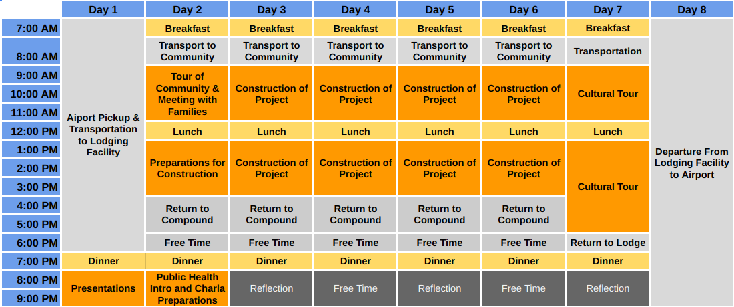
Sample Itinerary
(8 Days)
Note: This is a typical Global Brigade Public Health Brigade itinerary.
We have added extra days to this itinerary for students to experience other parts of Ghana.

Slide 20
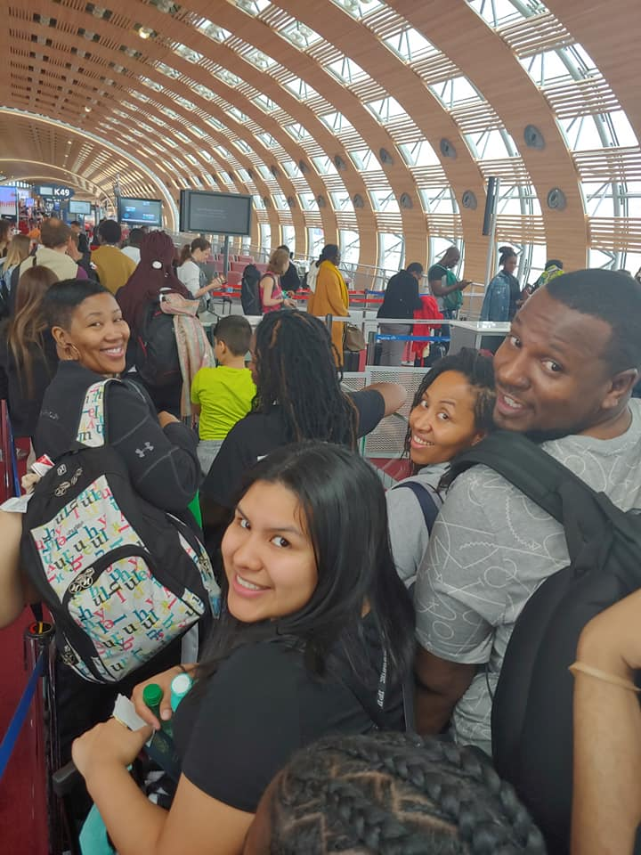
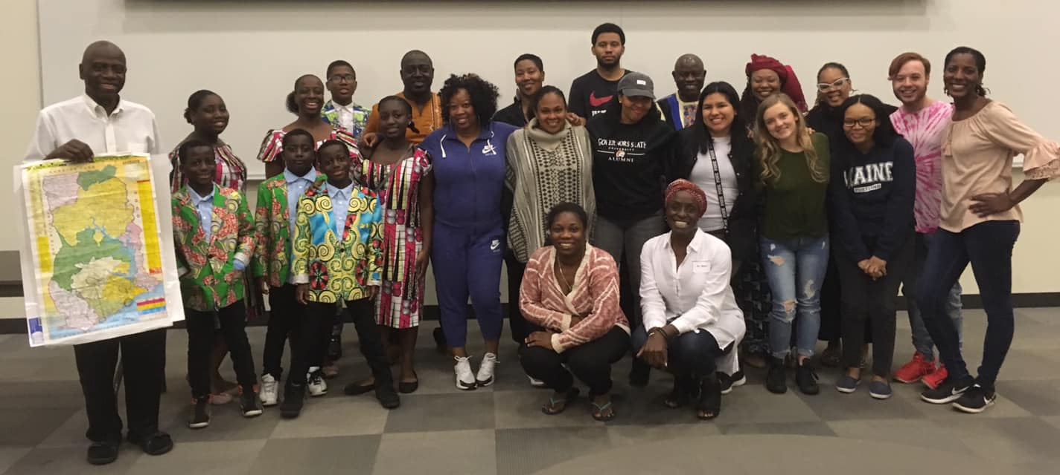
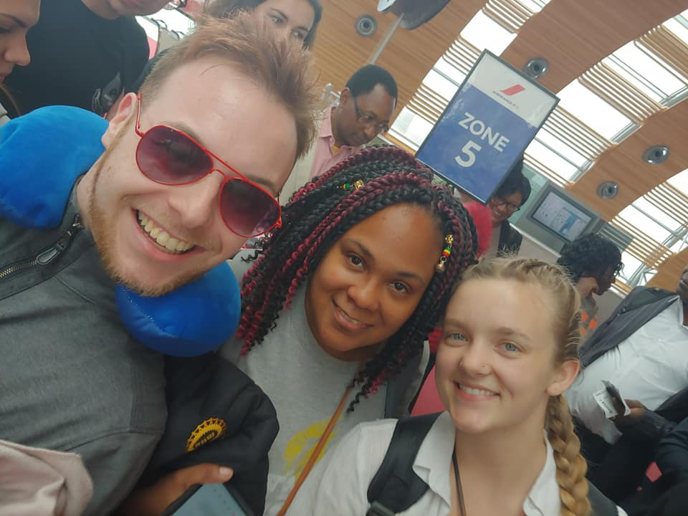
Itinerary
PRE-DEPARTURE
Teambuilding, education, cultural preparation, fundraising
Health, safety & travel preparation
Engagement with Ghanaian community members in the Chicago area
DEPARTURE
Meet at the airport and take group flight together to Ghana & Public Health

Slide 21
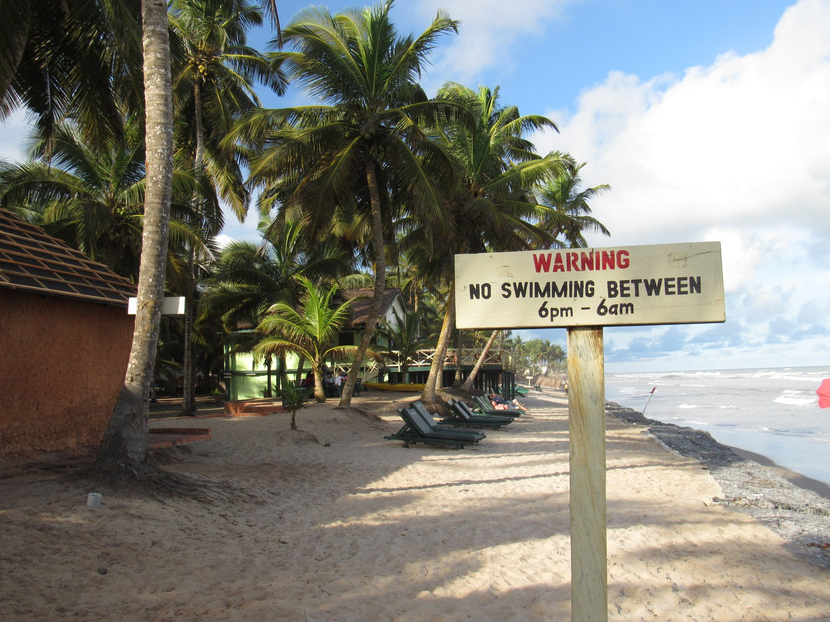
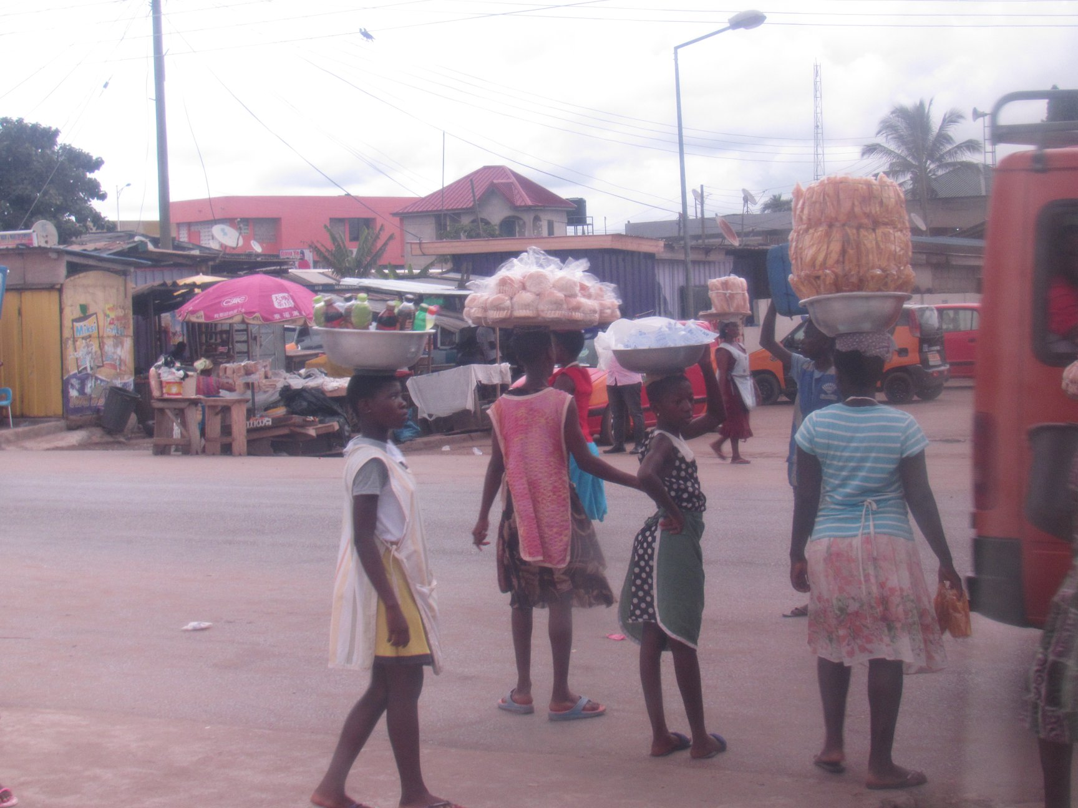
Itinerary
DAY 1: ARRIVAL IN ACCRA
DAY 2: PUBLIC HEALTH INTRODUCTION
Meet the Public Health Brigades team
Transportation to lodging facility
  Electricity, showers, bathrooms, beds, linens, pillows, 24 hour security, clean drinking water, daily meals provided
Introduction to Ghana & Public Health
  Challenges
  Community Needs
  Impact of Public Health projects
DAY 3: COMMUNITY VISIT AND HEALTHY HOUSEHOLD ASSESSMENT
Community visit
  Meeting with community leaders
Go on household visits
  Monitor and evaluate household health environment
  Offer recommendations to improve public health projects
  Record household data on tracking sheets and compile into post-brigade reports

Slide 22
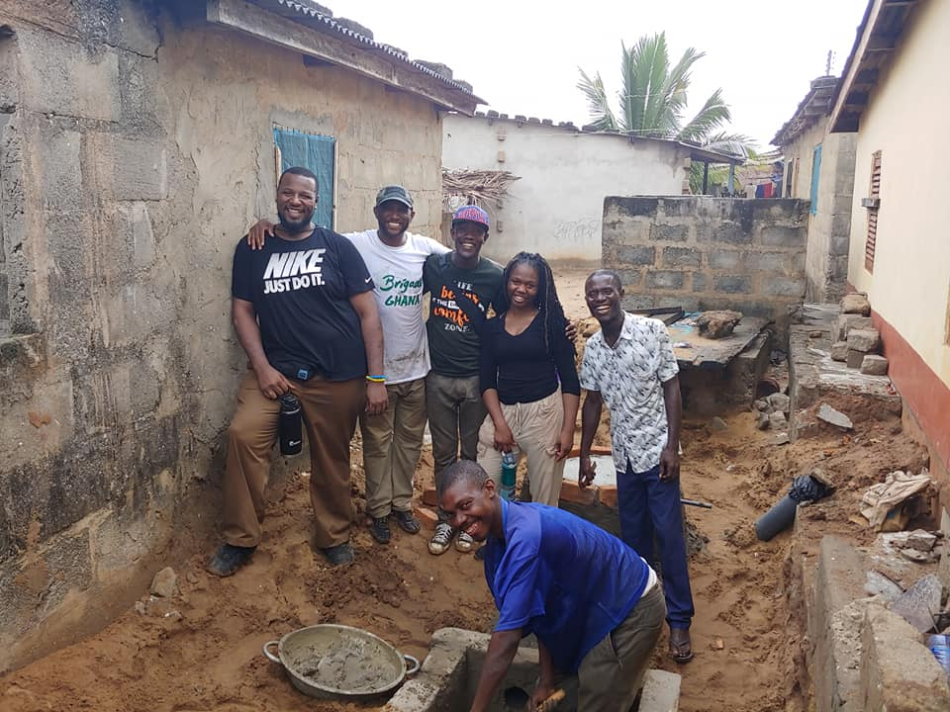
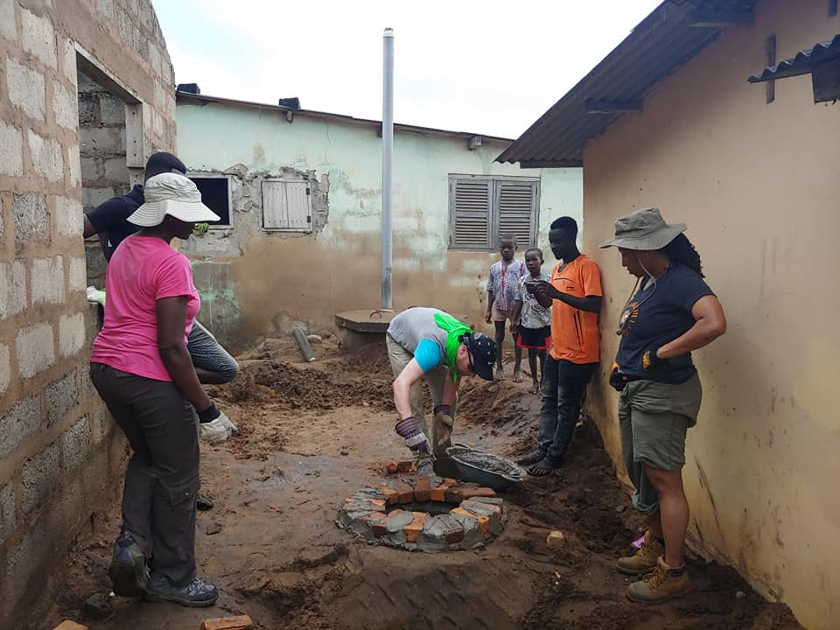
Itinerary
DAYS 4-6: PROJECT IMPLEMENTATION
Construct Public Health projects in households
  Divide into small groups to work in households alongside local masons and family members
  Bond with and learn from family members
Projects consist of:
  Eco-stoves
  Latrines
DAY 7: EDUCATION WORKSHOP AND PUBLIC HEALTH FAMILY GOODBYES
Lead interactive educational workshop (skits, posters, etc.)
Common education topics:
  The importance of public health projects, Personal hygiene, Waste management
Education ensures projects are sustainable in the future
Say goodbye to families from project implementation days

Slide 23
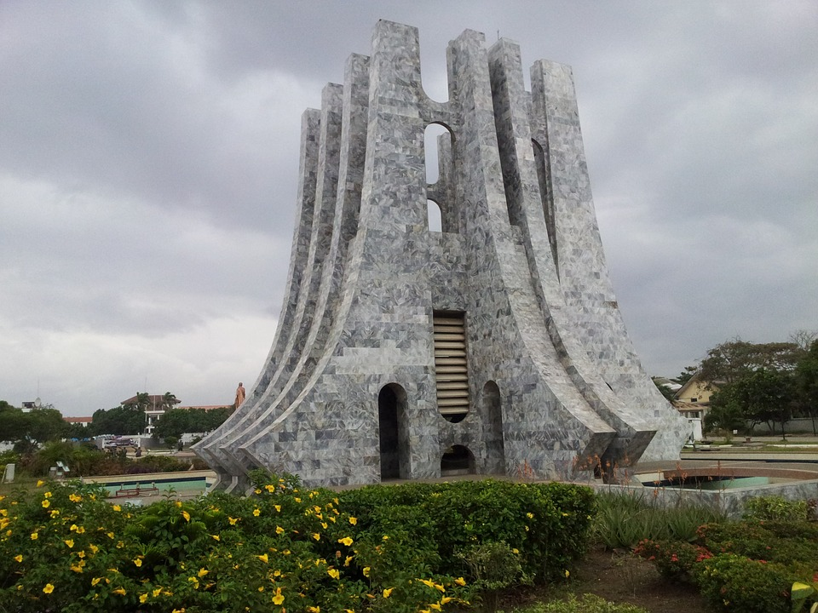
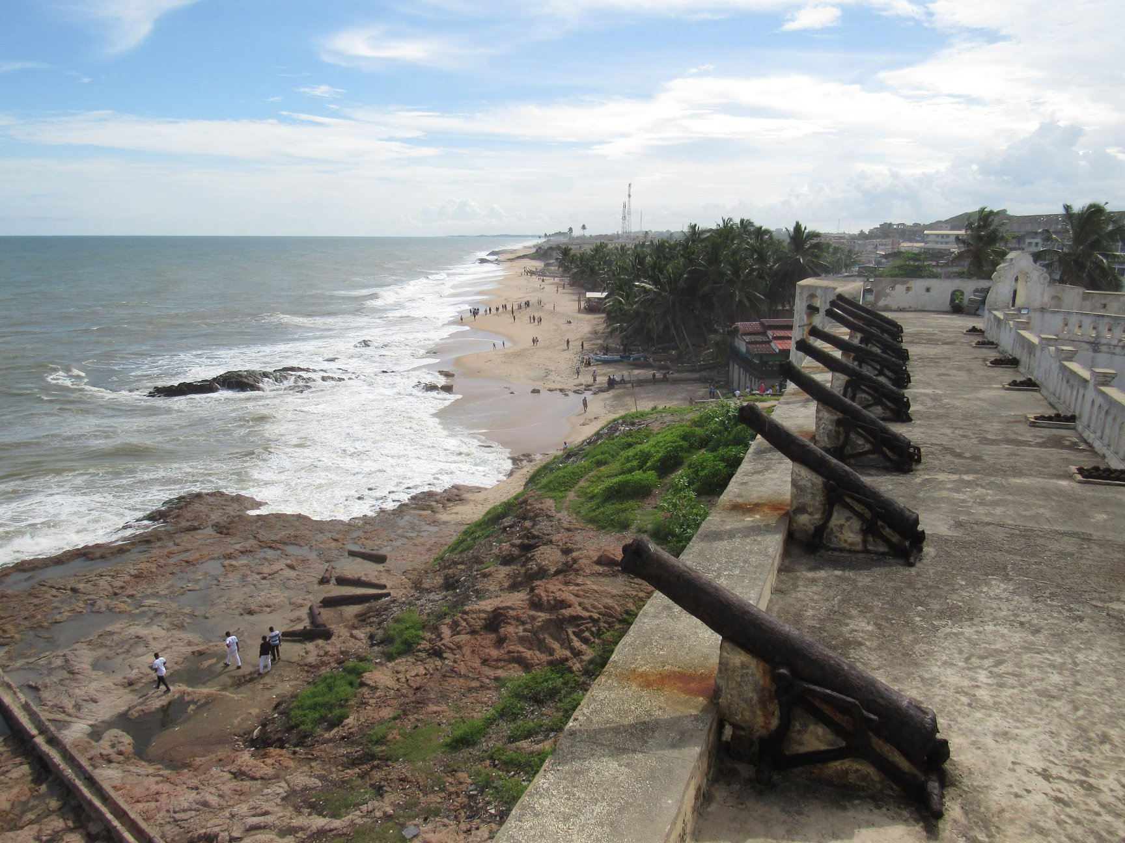
Itinerary
DAY 8: CULTURAL DAY
Cultural Tour (Last Bath)
Lunch
Cape Coast Castle Tour

Slide 24
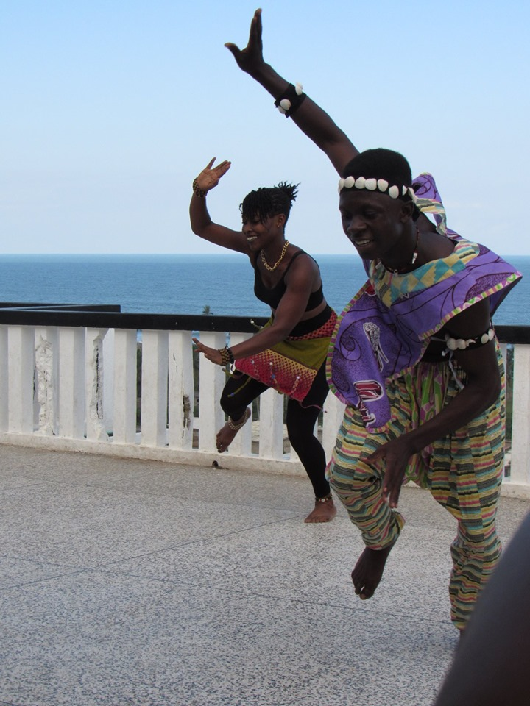
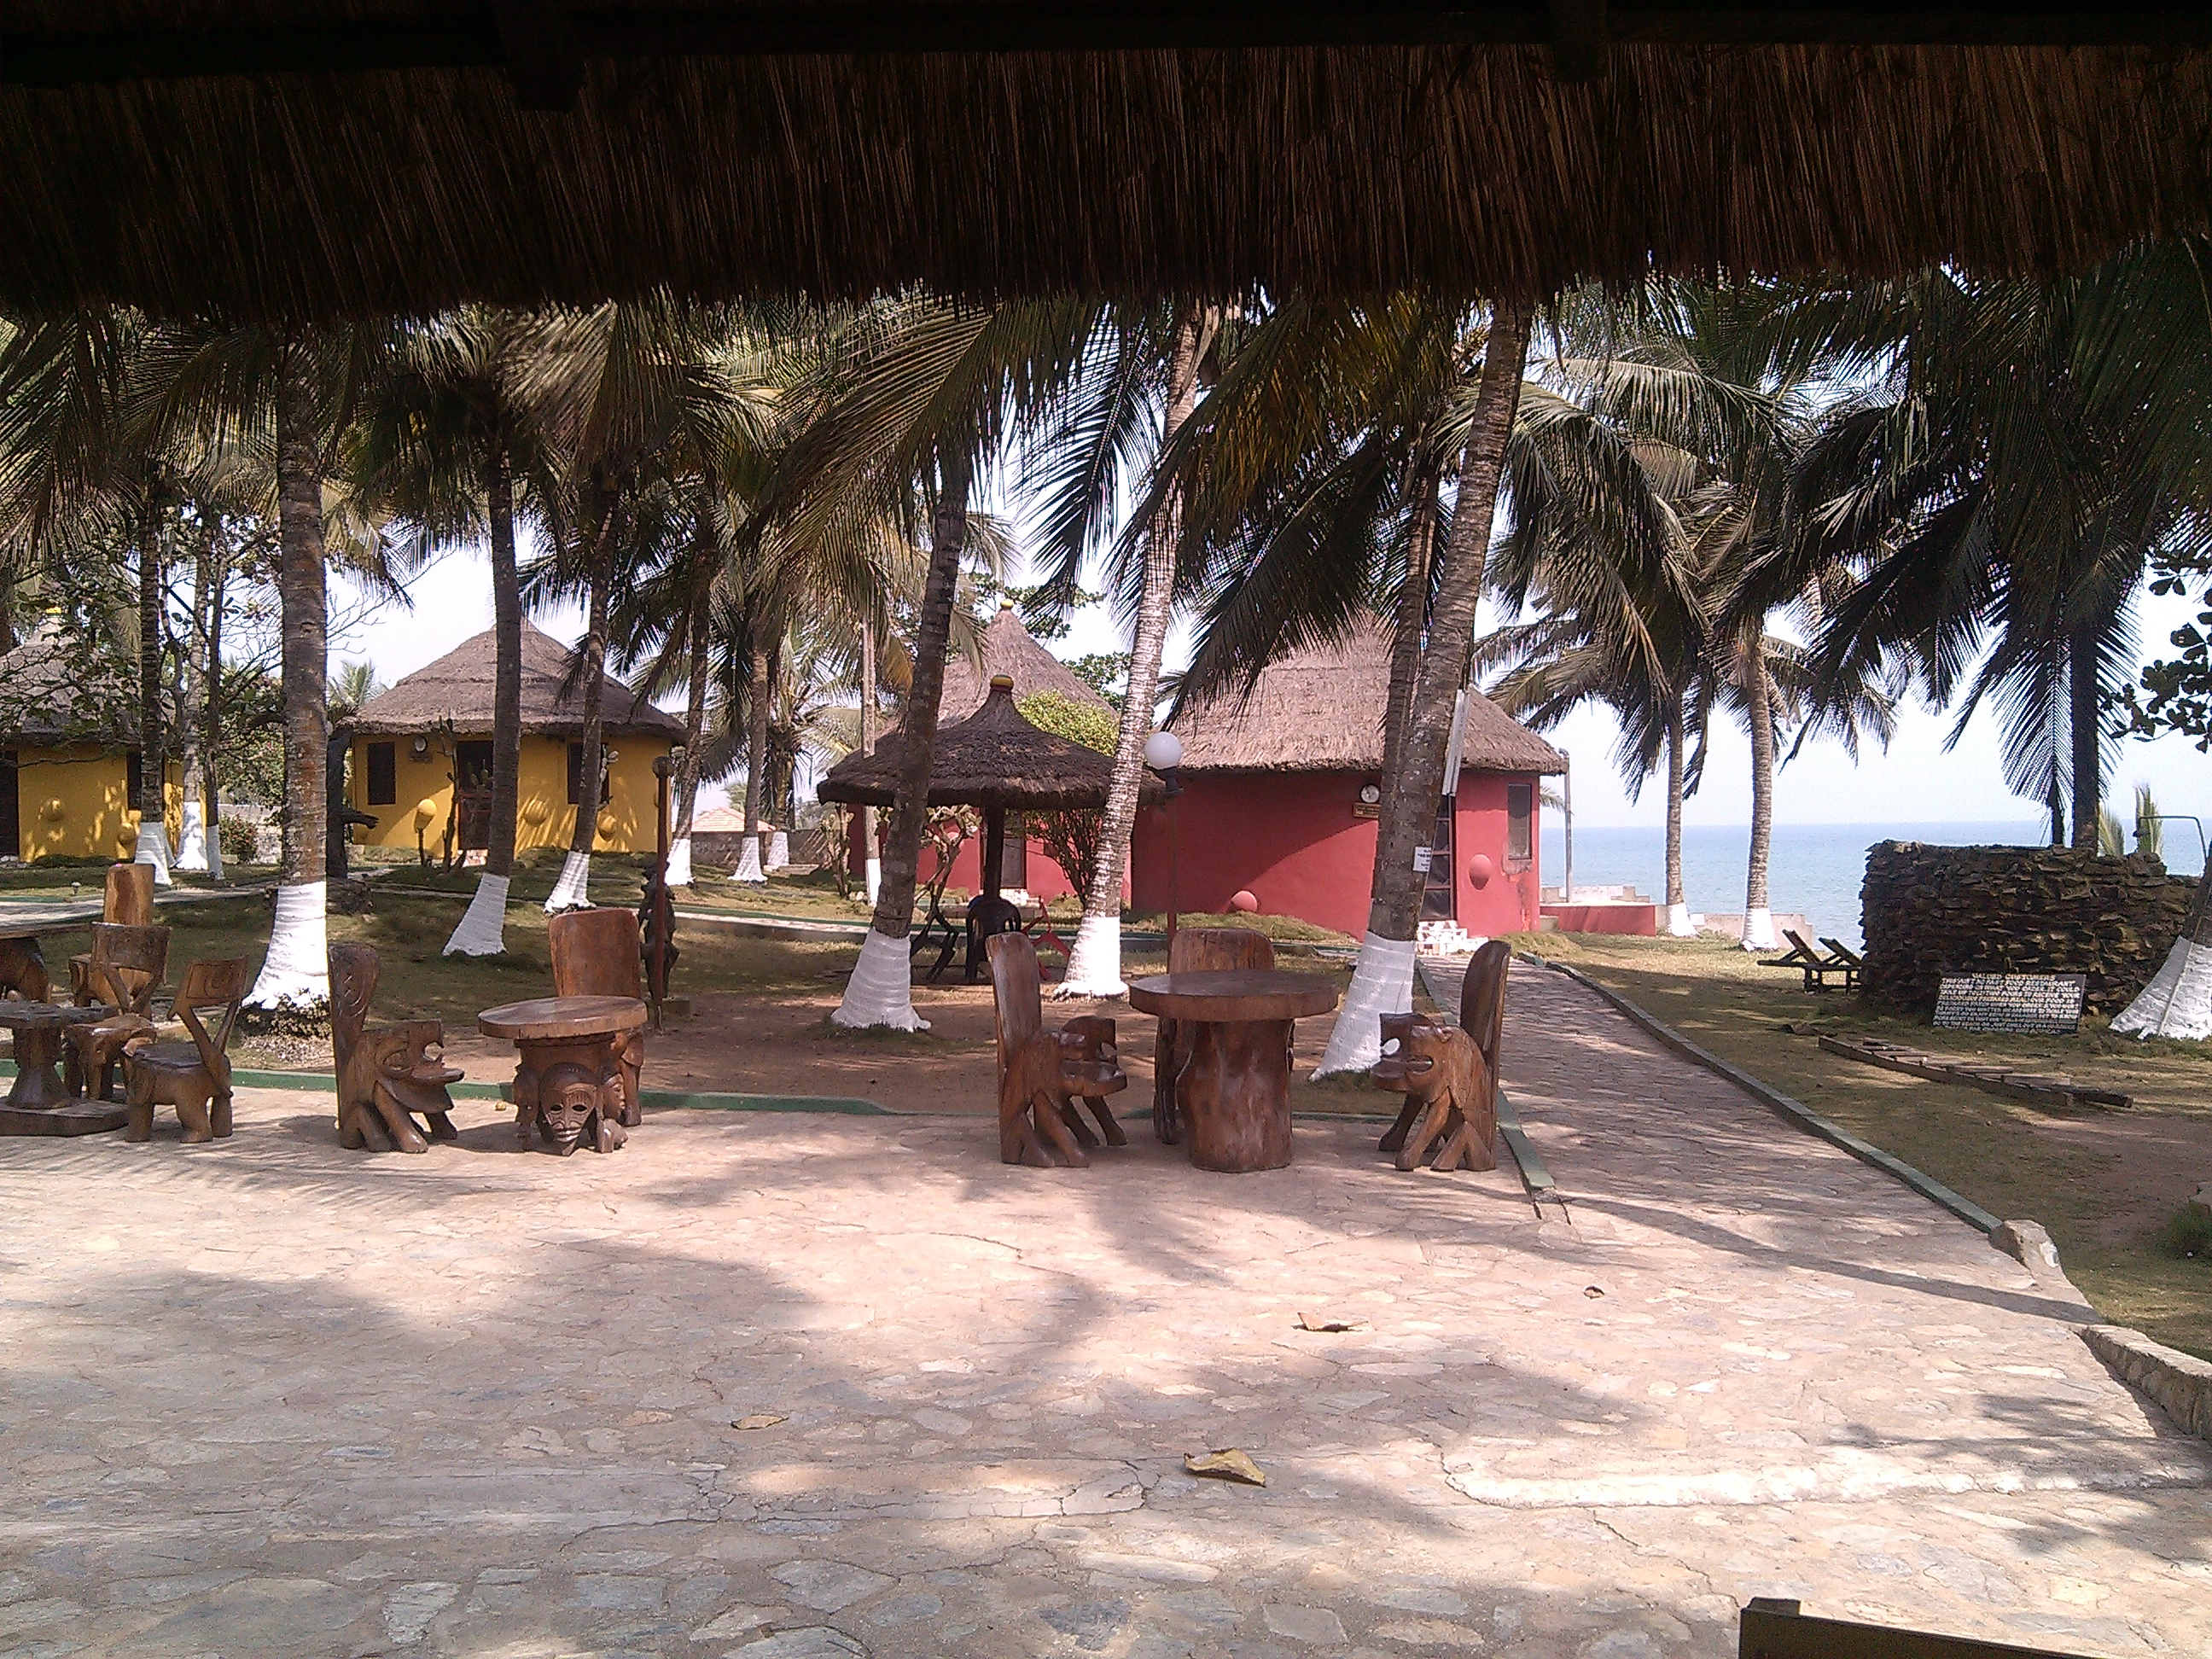
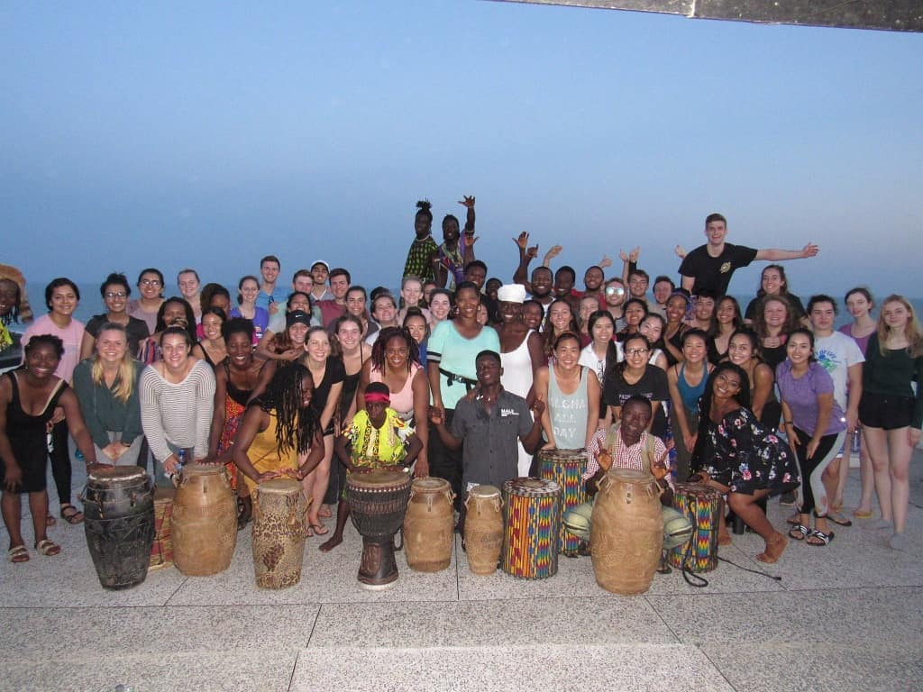
Itinerary
DAY 9 & 10: ONE AFRICA
Cultural Tour
Lunch at One Africa
Cultural immersions (Cultural Dance)
Final Reflections with GB Ghana Staff

Slide 25
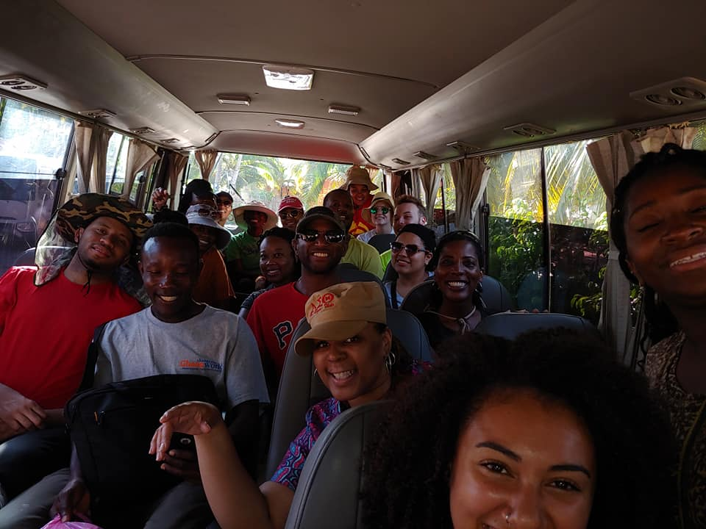
Itinerary
DAY 11: DEPARTURE
Transportation to airport
Start planning for your next brigade!
  Set goals
  Leadership positions
Share your story!
Get connected through Global Brigades’ networks
  Get updates on the community you worked with
Learn & share about public health challenges in your community & around the world

Slide 26
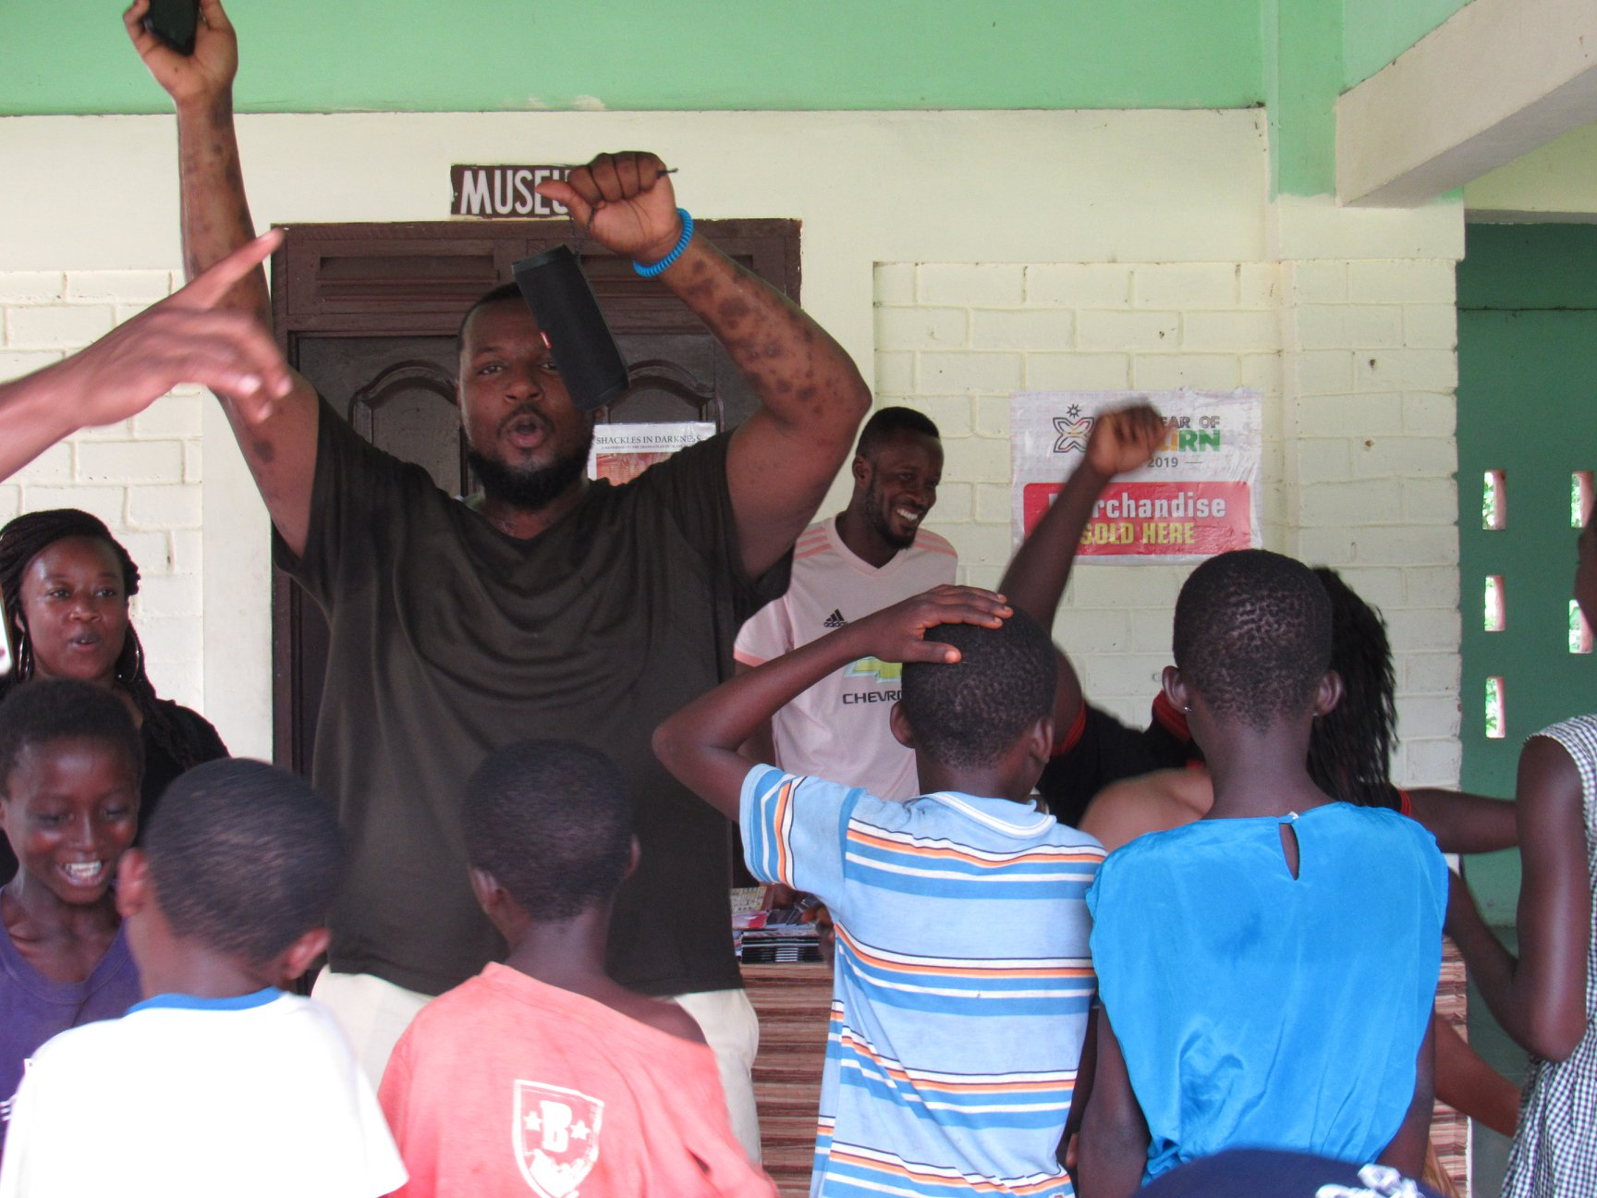
Public Health Brigades
EDUCATION WORKSHOPS
Adult and Family Health Education
Focuses on the importance, care, and maintenance of the construction projects
This also initiates the proper dialogue to share other critical health concepts, such as treatment of potable drinking water and proper sanitation practices
Kids’ Health Education
Dynamic mix of songs, games, and interactive simple activities but highly effective
Teaches health promotion and disease prevention methods, and serves as a supplement to health education already taking place in the classroom

Slide 27
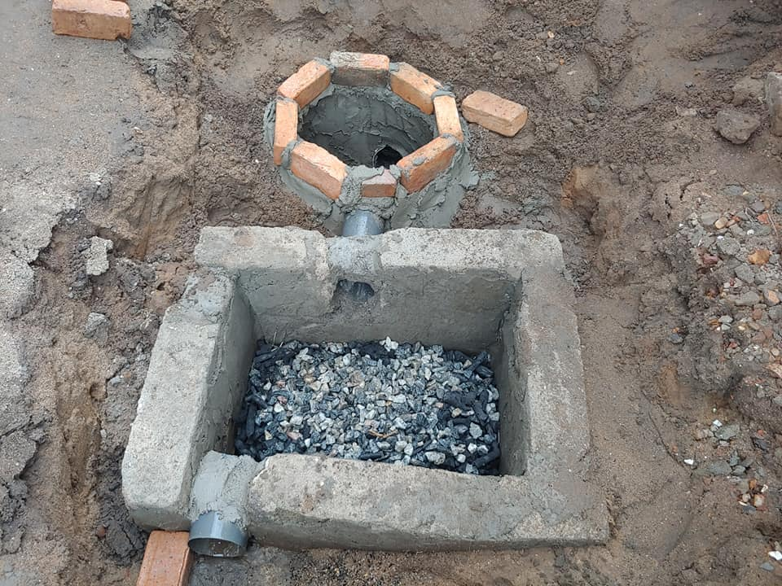
The
Result

Slide 28
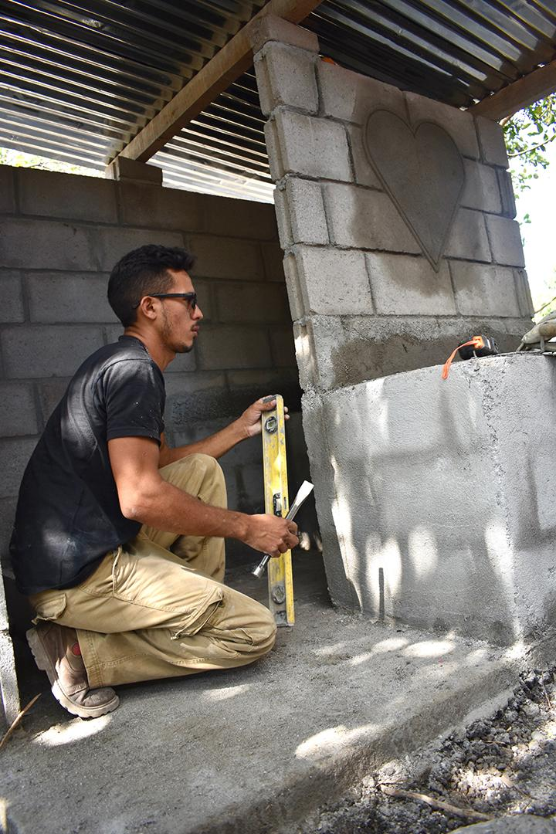
The Result
HEALTH
CHWs serve as a sustainable health care presence in communities
Medical Brigades will see decreased numbers of patients experiencing illnesses related to the healthy household projects such as skin diseases and respiratory illnesses
SANITATION AND HYGIENE
Households have access to a proper waste disposal system

Slide 29
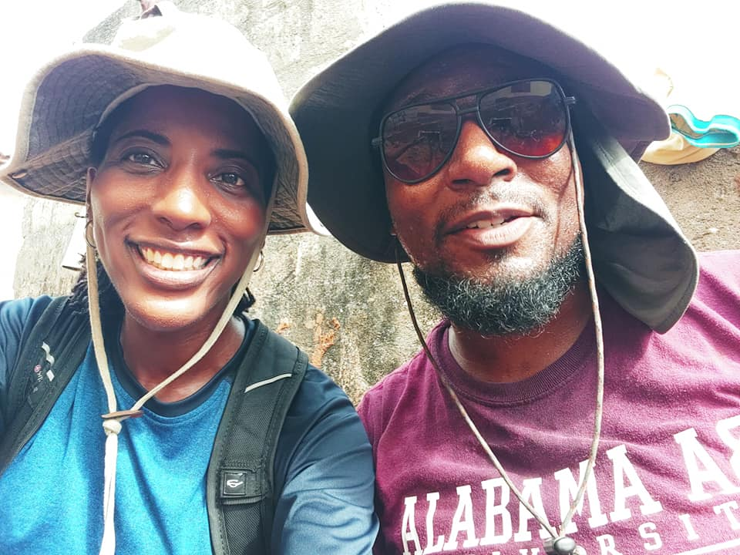
Get
Involved

Slide 30
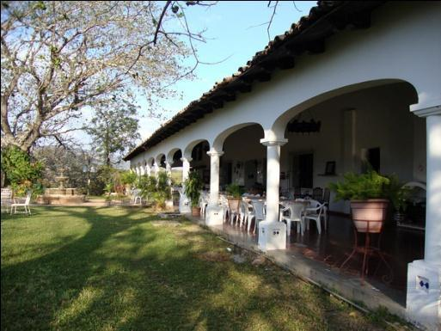
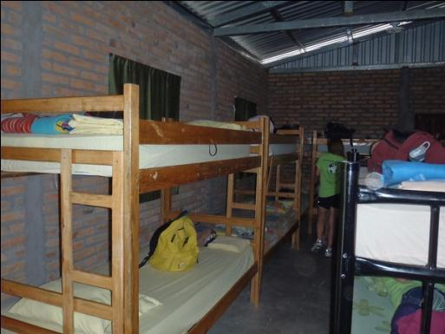
PUBLIC HEALTH BRIGADES INFO SESSION – TOTAL CONTRIBUTION
Program Fee: 3,450
PROGRAM CONTRIBUTION DETAILS
Accommodations & meals (vegetarian options available)
Clean drinking water
Airport pick-up and drop-off
In-country transportation
Translators and coordinators, and security
Program sustainability and follow-up between brigades
Site Visits and tours
Public Health Project Materials
International flight
International health insurance
Ghana Visa
COVID Testing
Flight Insurance
Notes:
Volunteers will be lodged in a group compound. All accommodations are clean and safe. There is electricity, bathrooms and clean drinking water on site. Meals are prepared on site using clean water and food specifically for the brigade. A GB staff member will be with the volunteers at all times and available for 24 hour assistance.
For the complete breakdown visit - http://globalbrigades.wikidot.com/student-materials:program-donations:program-contribution. Remember to express that the program contribution contains $100 towards the public health projects.
[ Actual lodging facility will most likely not be determined until a week or two before a brigade, due to logistics of arranging volunteers and frequent changing volunteer numbers up to the actual brigade. ]

Slide 31
PUBLIC HEALTH BRIGADES INFO SESSION
OUT OF POCKET EXPENSES
Vaccinations (COVID-19, Yellow Fever, Typhoid, Hep A, Hep B, Malaria)
Pre-Departure COVID testing
Tuition & fees/ auditing fee of $75
Please note, due to the uncertainty of the ongoing pandemic, your program may be subject to additional expenses to meet new required government policies and procedures. GSU will make best efforts to communicate new rules and policies as soon as we learn in order to share the impact on your program.
Notes:
Volunteers will be lodged in a group compound. All accommodations are clean and safe. There is electricity, bathrooms and clean drinking water on site. Meals are prepared on site using clean water and food specifically for the brigade. A GB staff member will be with the volunteers at all times and available for 24 hour assistance.
For the complete breakdown visit - http://globalbrigades.wikidot.com/student-materials:program-donations:program-contribution. Remember to express that the program contribution contains $100 towards the public health projects.
[ Actual lodging facility will most likely not be determined until a week or two before a brigade, due to logistics of arranging volunteers and frequent changing volunteer numbers up to the actual brigade. ]

Slide 32
Health & Safety
Department of State: LEVEL 2 – Exercise increased caution.
CDC: LEVEL 1 - Low - Make sure you are fully vaccinated before traveling to the Ghana.
GSU will be closely monitoring the travel advisories and other health and safety risks as we get closer to the travel period.

Slide 33
COVID-19
PRECAUTIONS
All participants must be fully vaccinated
COVID testing is required prior to travel, upon arrival in country and upon departure (cost of in-country testing is covered by program fee)
COVID insurance
Reduced capacity with accommodations and vehicles
All volunteers must wear masks at all times
Global Brigades hired a new COVID-19 coordinator
Daily Temperature testing
Any symptoms are reported to the doctor on the compound
The requirements for travel are changing everyday.
Resources: Please find the list of resources that could be helpful to understand the situation in Ghana:
Ghana Health Services
Reuters
WHO
COVID-19 Safety Protocols
Responding to Covid-19 (Global Brigades)

Slide 34

Insurance
International Health Insurance
All participants will be enrolled in international health insurance. Ask OIS for more details on the plan.
Treatment for COVID-19 would be considered like any other medical condition and is subject to the policy terms and conditions. If you experience symptoms, you should seek medical care. Expenses resulting from Medically Necessary treatment will be considered for reimbursement according to the policy terms, conditions and exclusions.
GSU has added quarantine coverage up to $2,000 per participant.
Cancel for Any Reason Insurance (CFAR)
Participants will be enrolled in Cancel for Any Reason insurance. Ask OIS for more details on the plan.

Slide 35
Protecting your investment
All payments made towards the brigade are refundable until February 1st
By February 4th, GSU will make a decision to cancel or move forward with the program
At that time, students will have the option to receive a full refund or purchase Cancel for Any Reason or Interrupt for Any Reason insurance

Slide 36
GSU Study Abroad Scholarship
1. Study Abroad Scholarship Application Form
2. Statement of Purpose Essay with Follow-on Project
3. Two letters of recommendation or recommendation forms filled out by academic or professional references.
4. A current copy of your resume
Statement of Purpose Essay with Follow-on Project Specifics:
• 500-1000 words
• Typed, one-inch margins, double-spaced, 12 pt. font
• Include one-line header in the top-right corner with your Name and Student ID
• Pay attention to detail in terms of grammar and style
The essay is comprised of three parts. Please read below for details.
1. Reasons for Studying Abroad – Address the impact that your study abroad program will have on your academic, professional, and personal goals. You should also address the impact that receiving the Study Abroad Scholarship would have on your achievement of these goals.
2. Challenges – What challenges, if any, did you face in your decision to study or intern abroad? How did you meet these challenges and what impact do you foresee them having on your experience abroad? These could include, but are not limited to, being a parent, being a non-traditional student, having a learning or physical disability, being in a field of study for which it is difficult to incorporate study abroad, etc.
3. Follow-on Project Proposal – The Follow-on Project Proposal is your chance to explain how you will give back by inspiring others to pursue their own experiences abroad. To help expand the impact of the GSU Study Abroad Scholarship Program, all scholarship recipients are required to carry out a Follow-on Project that helps to promote international education and study abroad. This project can be done virtually while you are abroad, on your home campus or in your local community and must be completed within six months of your return to the United States. All applicants must describe their project proposal within the essay as part of and this proposal is closely reviewed during the selection process.
Open to all active GSU students
Awards of up to $750
Application Deadline: March 1st, 2022

Slide 37
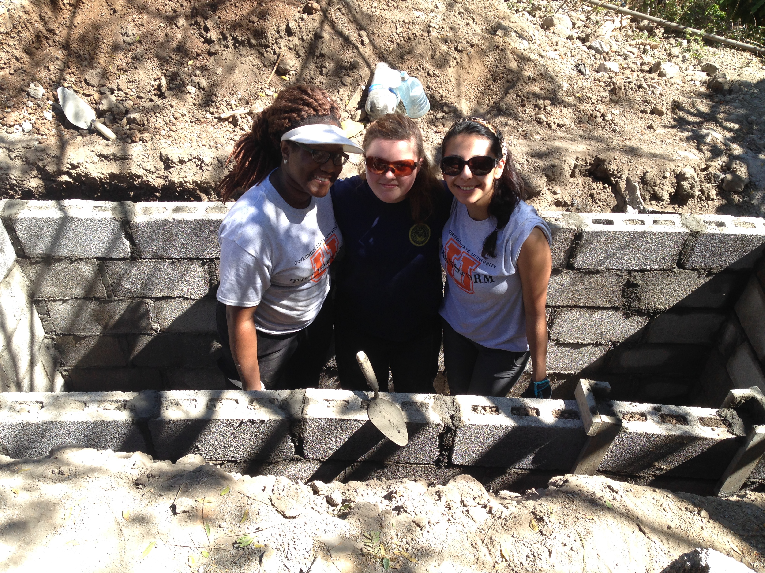
Leadership Grants
Three $250 Grants are available to students attending the GSU Public Health Brigade program to Ghana for the purpose of coordinating three key areas that include: 1) group development 2) fundraising and 3) global brigade curriculum. Successful students will receive their grant upon completion of a campus program reflecting on the trip experience.
Time Commitment:
Pre-Service Trip: Under the direction of faculty advisors, execute responsibility of leadership positions. (see description below).
During Trip: Continue to execute leadership positions as needed.
Post-Trip: Under the direction of the Office of International Services, host campus forum describing service-experience in Ghana.
All three students will collaborate on the following:
Group Development: Plan and coordinate activities designed to build a strong team and develop and motivate group through the fundraising efforts and in planning for the program.
Education: Responsible for facilitating and presenting the Pre-Brigade Curriculum, preparing group for reflection and education workshops during the brigade, and leading members during those reflections and education workshops presentations during brigade (alongside Faculty Advisors).
Fundraising: Plan and coordinate fundraising events, reach out to corporate sponsors, and draft grant applications. Work with college/university to gain fullest possible support for Chapter.
APPLICATION DEADLINE: January 20th, 2021

Slide 38

Dr. Phyllis West Global Service Learning Scholarship
Dr. Phyllis West, former Senior Lecturer in the Social Work Department at GSU and Peace Corps Volunteer, was instrumental in implementing and ensuring the success of Service Learning Abroad at GSU. During her time at GSU, she led six brigades to Nicaragua, Panama, and Ghana, touching the lives of hundreds of students, coordinators, and community members. Through her dedication and passion for serving others, she has opened opportunities for students who never dreamed of serving abroad, making this a reality.
One grant is available to a student interested in attending the Global Brigade to Ghana for the purpose of allowing participation in a high-impact practice, development of leadership skills, enhancement of social responsibility, improvement of writing skills and identification of the path towards career development.
The Global Service Learning Scholar will be an ambassador for GSU and the USA. The grant will cover the entire program fee including passport and vaccination fees.
Requirements: Applicant must be a first generation college student who has never been outside of the U.S.A. Minimum cumulative GPA requirements are 2.5 for undergraduates and 3.0 for graduates and doctoral students. Student must also be in good financial and community standing at GSU.
APPLICATION DEADLINE: January 20th, 2022

Slide 39
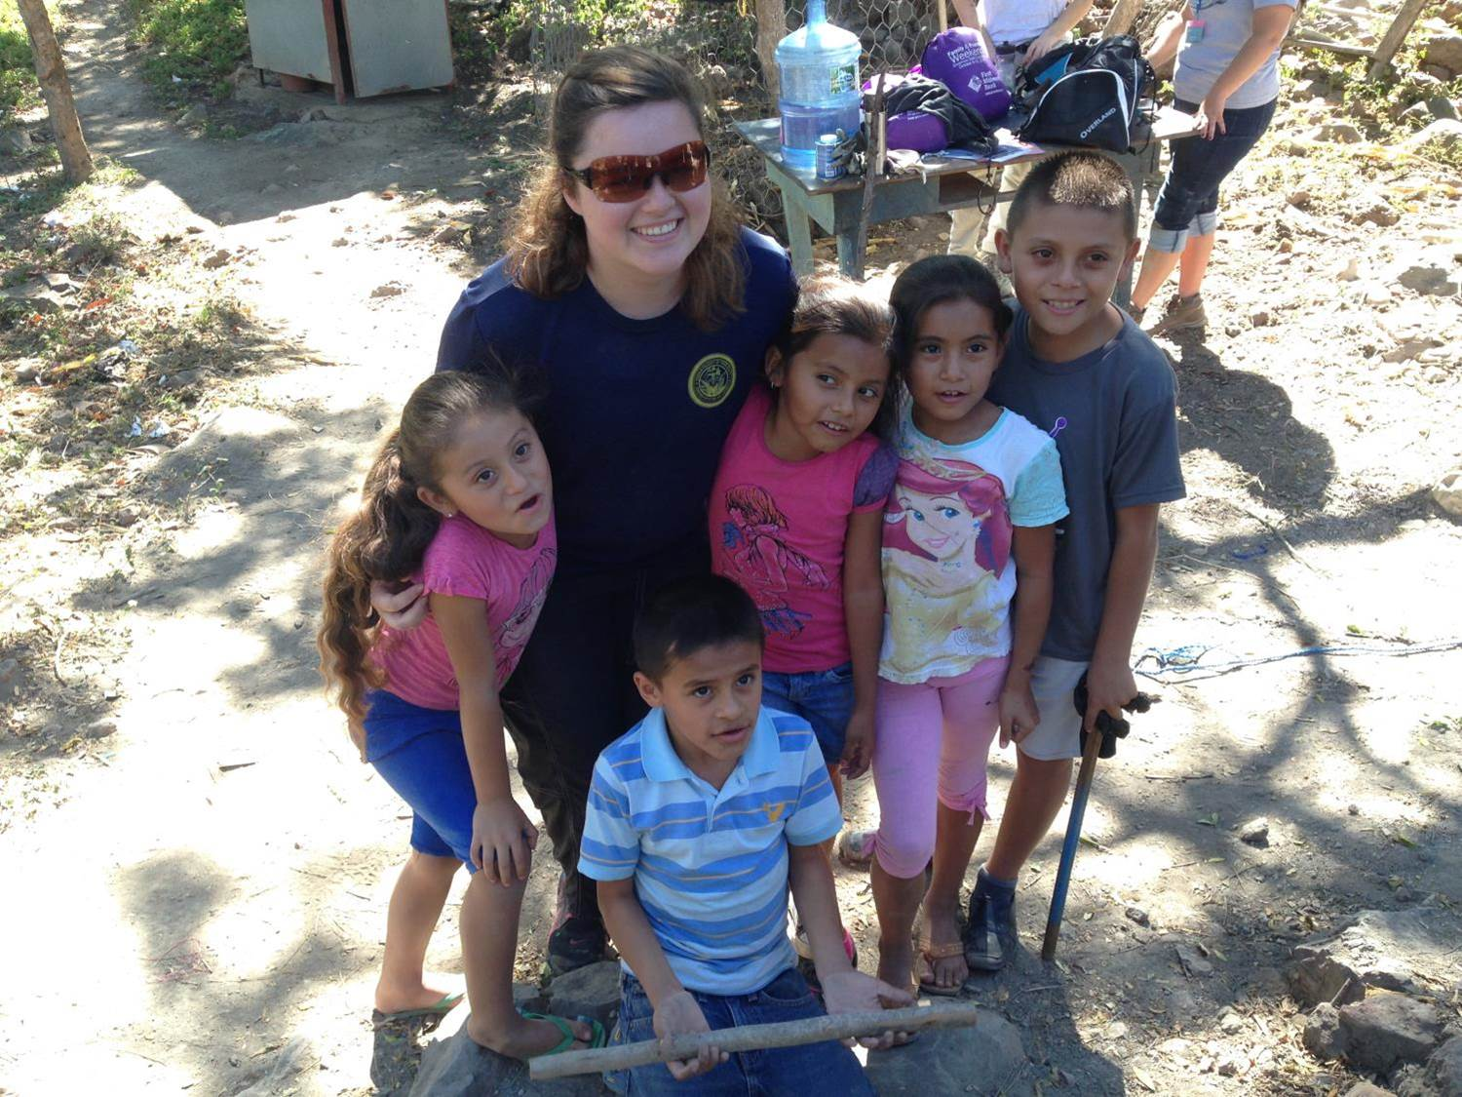
PUBLIC HEALTH BRIGADES INFO SESSION – CONTACT INFORMATION
FUNDING
    Financial Aid Refunds (if applicable)
    Student Life Travel Grant (if applicable)
    FUNDRAISING
    Traditional Ways: Bake Sales, Ice Cream Sale, etc.
    Reach out to Friends and Family for Donations
    Matching Donation Companies
    Local Businesses

Slide 40

Apply for your passport book
@ your local post office
Passport application
Passport photos
Proof of U.S. Citizenship (birth certificate)
ID (driver’s license, state ID)
Personal Check/Money Order
  $35 Administrative Fee
  $110 Passport Book - 11 weeks
  $60 Expedite - 7 weeks
  $17.56 – 1-2 Day shipping
Students planning to travel to Ghana should apply for their passport by January 15th through expedited service.
For full application instructions, please visit the Government Website.

Slide 41
PUBLIC HEALTH BRIGADES INFO SESSION – JOIN THE NEXT BRIGADE
Apply for passport by Jan. 15th expedited
Fill out application form and apply for grants/scholarships by Jan. 20th
Conduct Interview for acceptance
Pay first deposit by Jan. 28th (or upon acceptance)
Pay non-refundable payment by Feb. 4th
Confirm program and flights in February
Attend welcome meeting (Feb. 15th)
Apply for Study Abroad Scholarship by March 1st
Purchase Cancel For Any Reason Insurance
Pre-Brigade Curriculum
Submit visa documents (March 20)
Research vaccine info
Apply for external Scholarships (March)
Pay fourth payment by April 15th
Fundraise
Get Vaccinations & Submit proof to OIS
Pay Final Deposit by May 1st
Receive passports with visa
Pre-Departure Orientation (May)
APPLICATION DEADLINES:
Due January 20th
Study Abroad Application
Leadership Grant Applications
Dr. Phyllis West Global Service Learning Scholar Application
Due March 1st
Study Abroad Scholarship Application
PAYMENT DEADLINES:
First Deposit Due ($250) – Jan. 28
Second Payment Due ($600) – Feb. 4th
Third Payment Due ($600) – March 15th
Fourth Payment Due ($600) – April 15th
Final Payment Due (Remaining balance) – May 1st
Notes:
[ Consider adding more information to this slide, such as due dates for the brigade application, deposit due dates, next meeting date/time/location. ]

Slide 42
Join the
Movement
QUESTIONS?
Contact Info:
Amy Soub asoub1@govst.edu (Coordinator)
Dr. Nicole Koonce nkoonce@govst.edu (Faculty Leader)
Dr. Roseina Britton rbritton@govst.edu (Faculty Leader)

